Slide 1
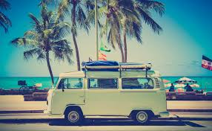
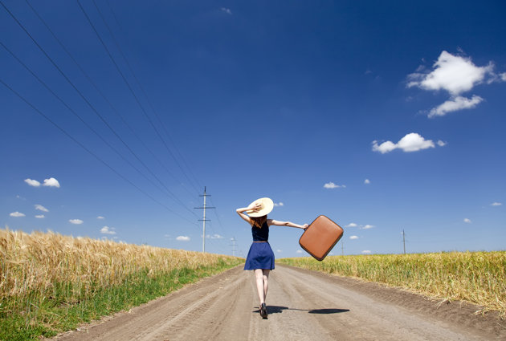
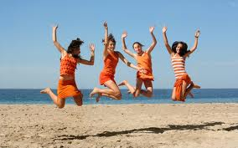
Unit 1 - Travel
Chapter 1: Scanning/ Organizing Vocabulary
Chapter 2: Predicting/ The prefix -off

Slide 2
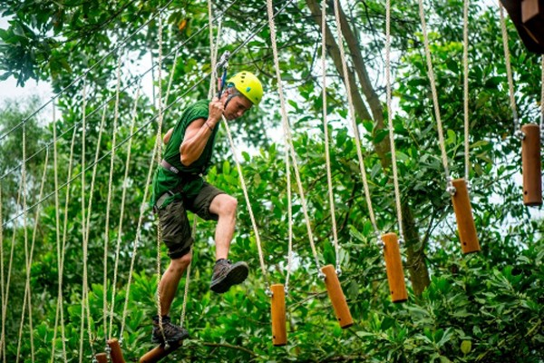
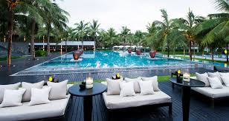
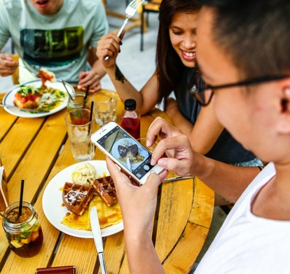
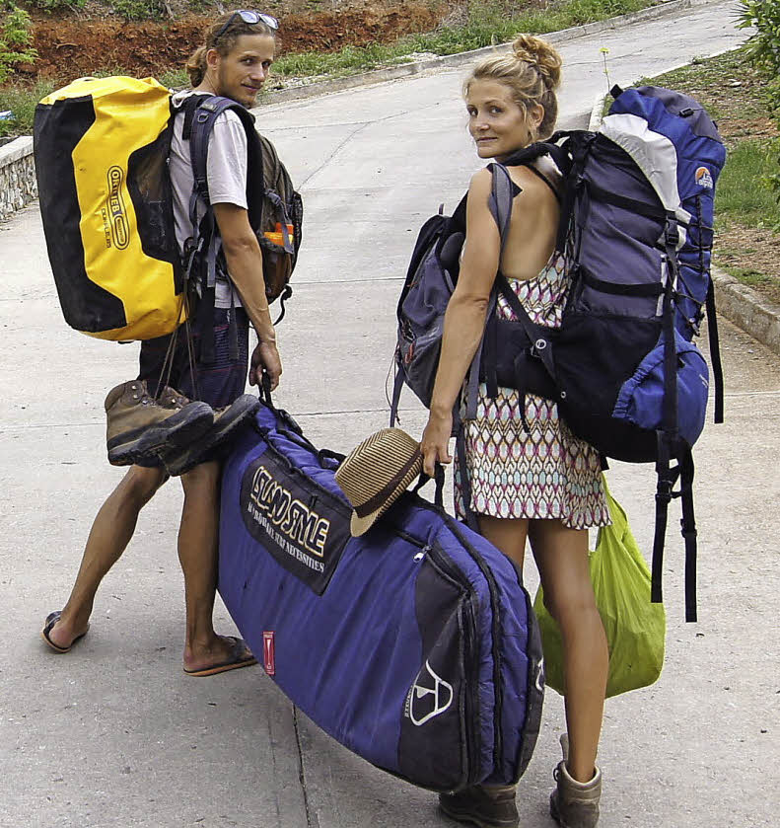
Getting ready
What kind of traveller are you?
How would you pack or prepare
for these vacation?

Slide 3

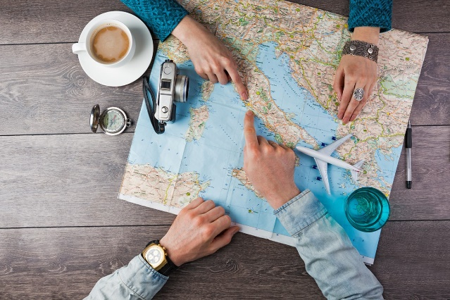
Group discussion
Name some places you’ve travelled?
Who (usually) arranges travel plan for you?
Today what helps us travel/ make travel arrangements more easily?

Slide 4
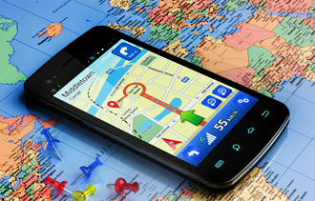

Chapter 1
Travel and technology

Slide 5
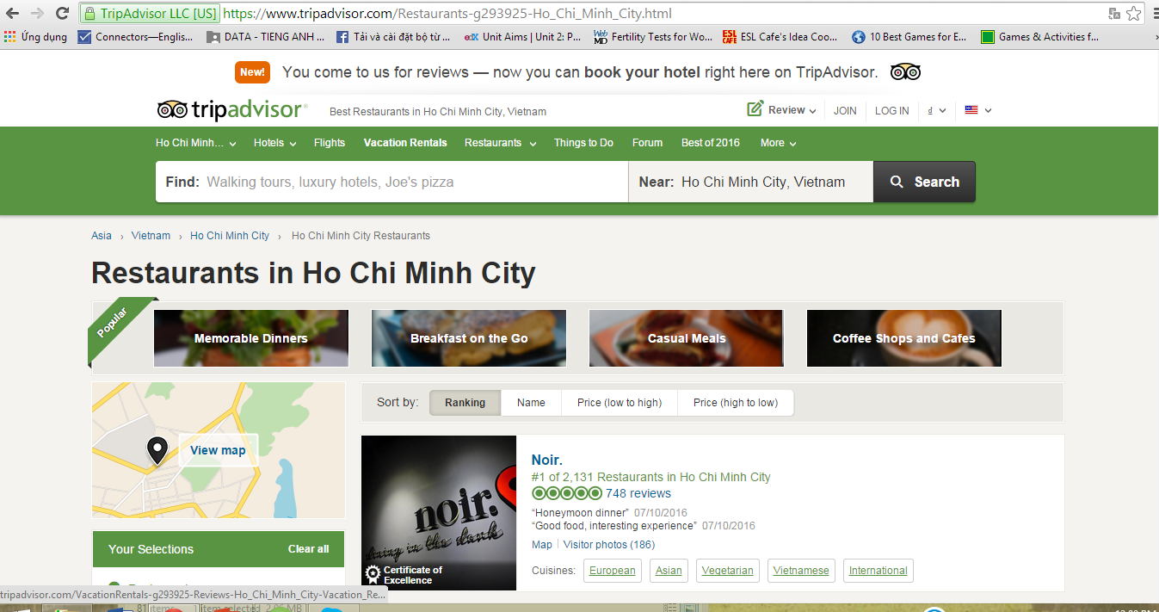
Have you ever heard of/ used these 3 technology advances:

Slide 6
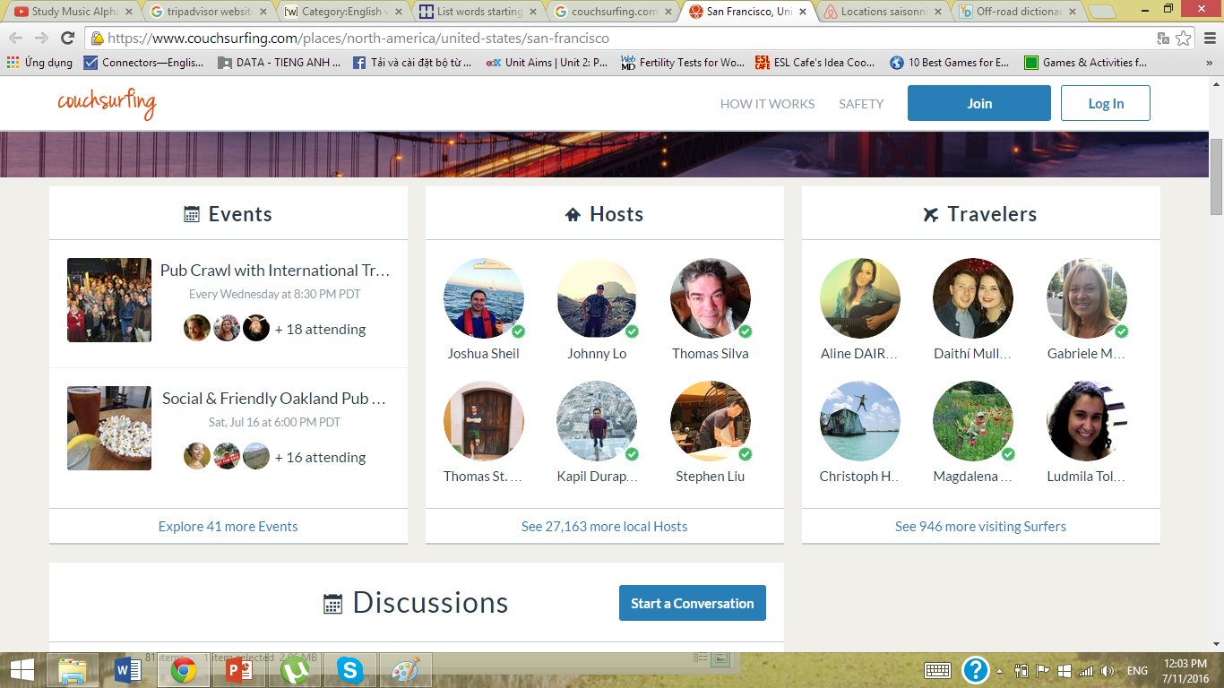
Have you ever heard of/ used these 3 technology advances:

Slide 7
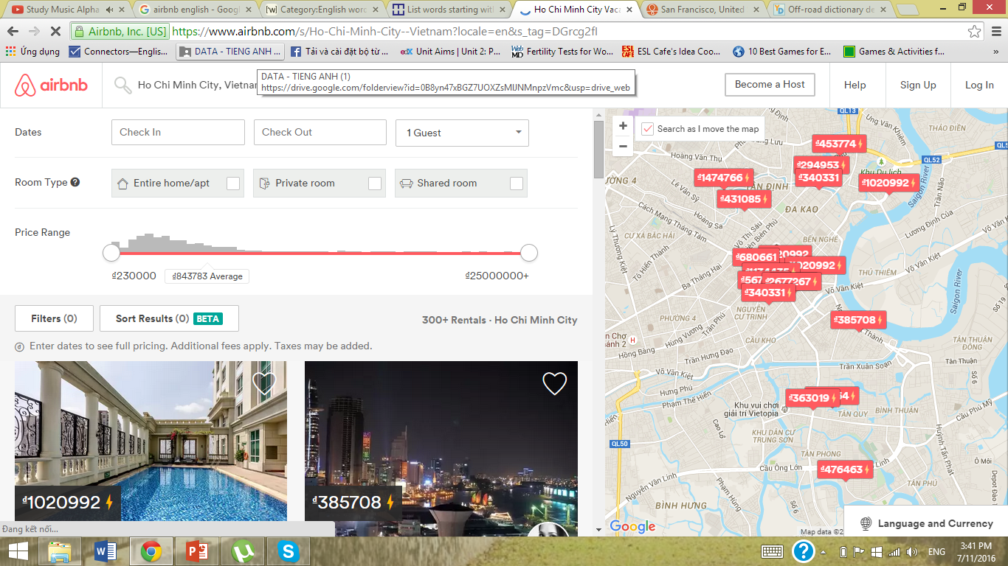
Have you ever heard of/ used these 3 technology advances:
TripAdvisor
Couchsurfing
Airbnb

Slide 8
Reading skill - Scanning
Scanning = Looking for a specific word/ phrase.
Now, look at p.13. Scan these words.
  Couch surfing
  Smartphone map
  TripAdvisor
  Airbnb
  Sightseeing apps
  Online forums
  Local hosts
If you find each word less than 5 seconds, you are a fast “scanner”
determiners

Slide 9
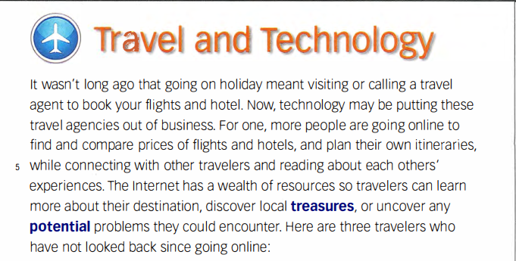

Slide 10
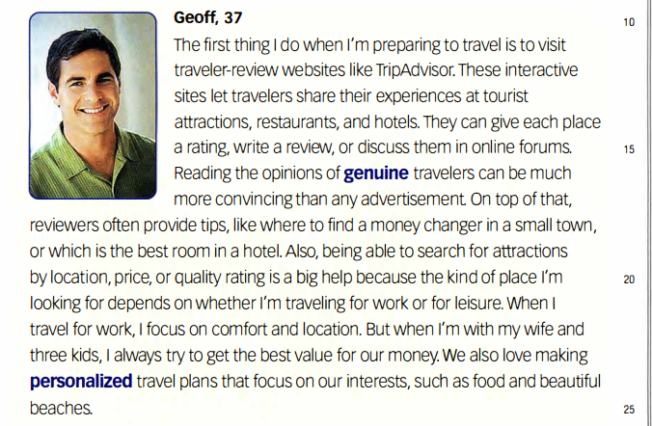

Slide 11
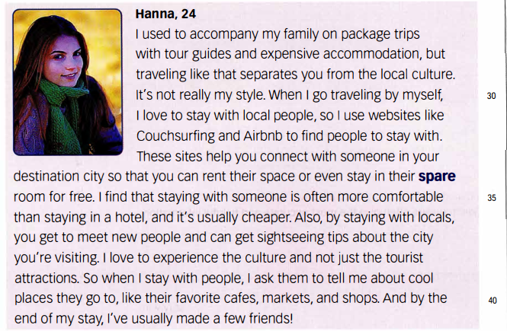

Slide 12
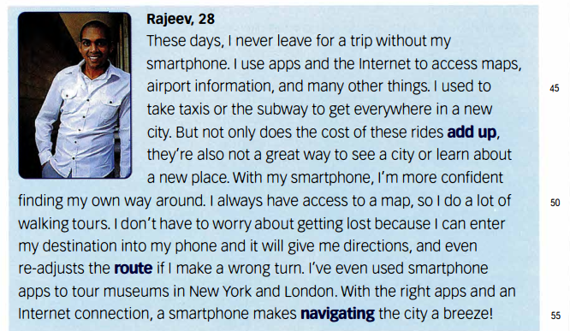

Slide 13
Reading skill - Scanning
As you’ve found the words, which one is used by Geoff, Hannah or Rajeev?
 | Geoff | Hannah | Rajeev
Couch surfing
Smartphone map
TripAdvisor
Airbnb
Sightseeing apps
Online forums
Local hosts
determiners

Slide 14
1. What kind of traveller is Geoff, Hannah or Rajeev?
2. How can TripAdvisor help Geoff? What can he find in Online forums?
3. What does Hannah love to experience? Why does she like to stay with the locals?
4. How has the technology helped Rajeev in travel now compare with before?

Slide 15
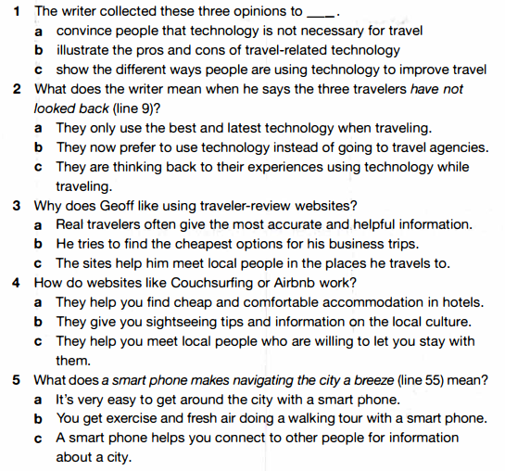
Reading comprehension - A

Slide 16
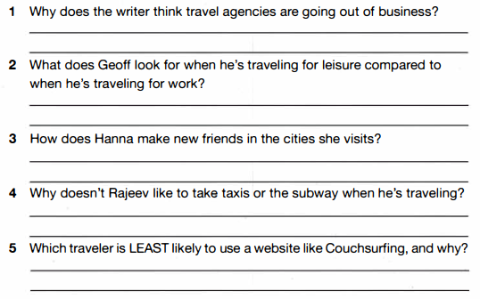
Reading comprehension - B

Slide 17
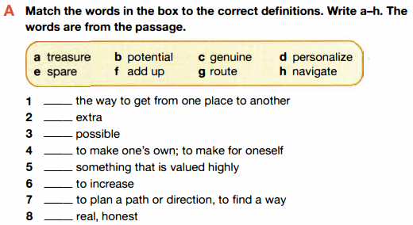

Vocabulary comprehension - A

Slide 18
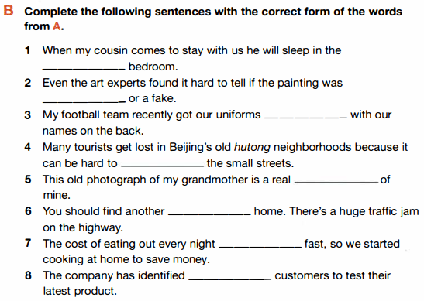
Vocabulary comprehension - B

Slide 19
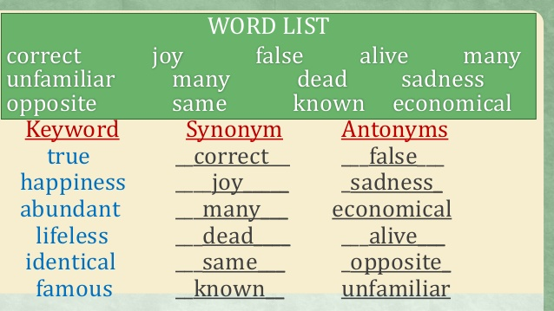
Vocabulary skill – Organizing vocabulary
Grouping words into meaningful categories to remember new words.
Group new words with words you already know that have similar/ opposite meanings
Group words by their parts of speech/ topic
determiners

Slide 20
Vocabulary skill – A
WORD | SYNONYM | ANTONYM
Genuine
Comfort
Spare
Frequently
Treasure

Slide 21

Vocabulary skill – C
Topic/ Category | WORDS
Words to describe expensive things | Treasure, value, quality

Slide 22
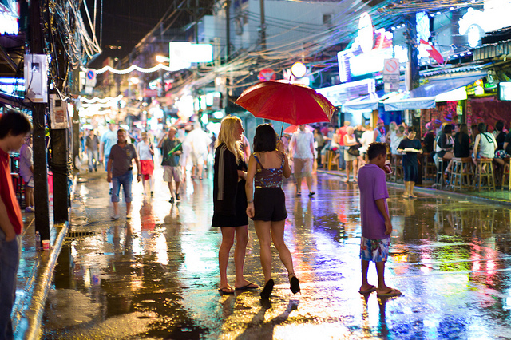
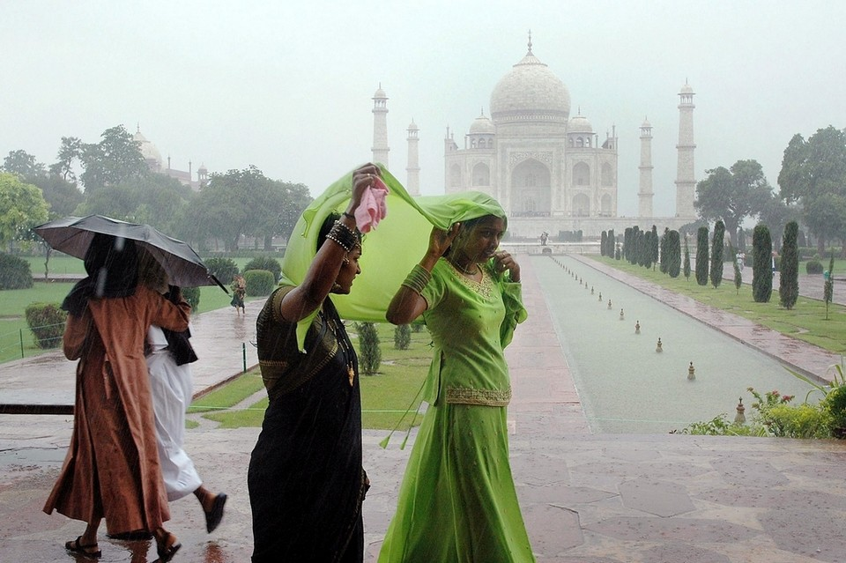
Chapter 2:
Selling India’s rainy Season
determiners

Slide 23
Before you read
Do people travel in rainy season?
What are some possible reasons why people travel in this season?
What are some activities for tourists when it rains?
determiners

Slide 24
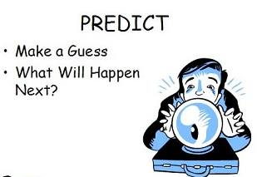
Reading skill - Predicting
Before reading, think about what you are going to read by look at the title, pictures, subheadings.
While reading, think about what comes next.
=> This helps you understand the passage better.
Now look at page 19 (title, pictures), what information you expect in this reading?
/ What can you guess about what
you are going to read?
What are we going to read?
What comes next?
determiners

Slide 25
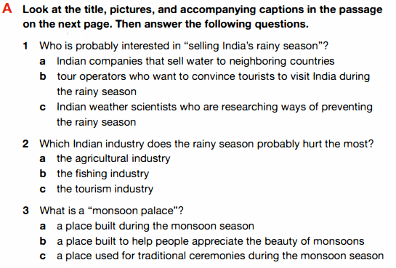
Reading skill - Predicting

Slide 26
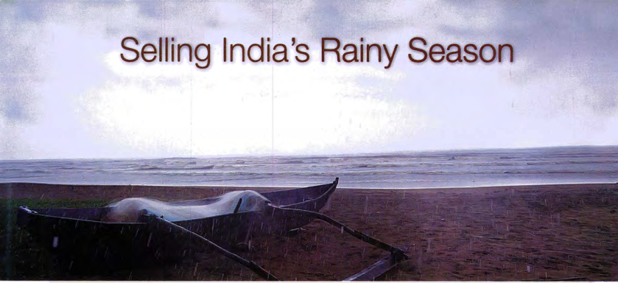
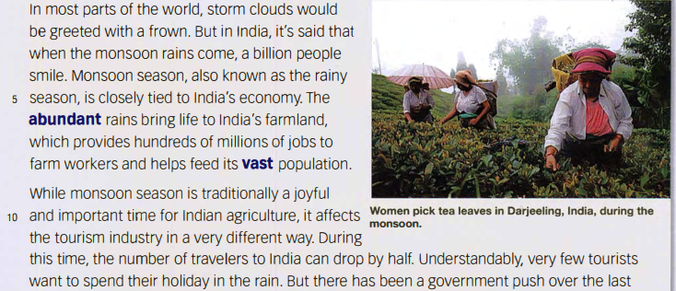

Slide 27
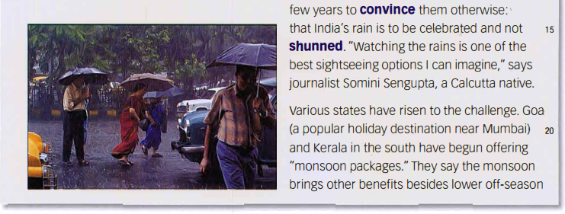
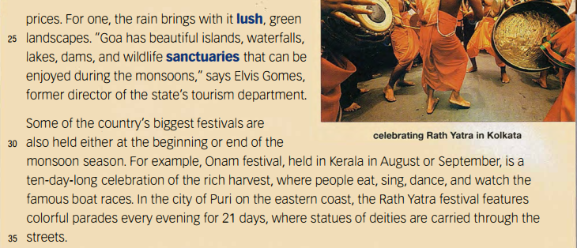

Slide 28
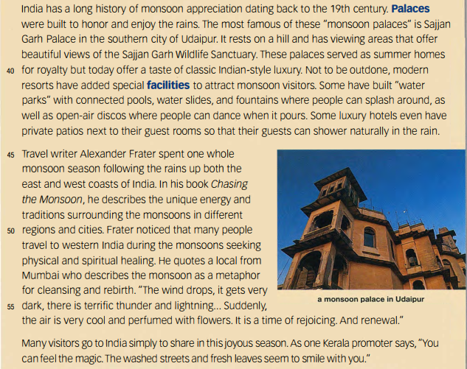

Slide 29
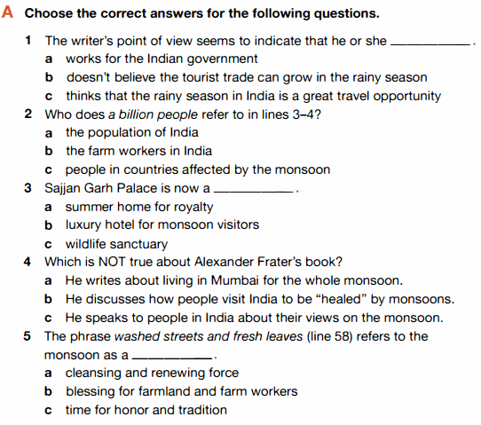
Reading comprehension - A

Slide 30
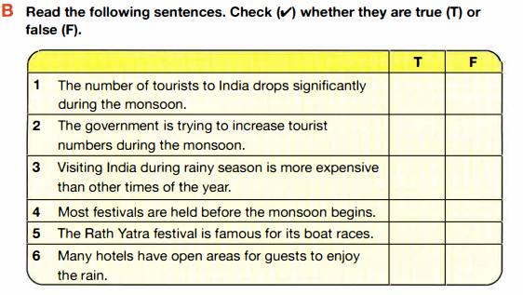
Reading comprehension - B

Slide 31
Vocabulary skill – Prefix off-
Find the sentence that includes the words “off-season”
…“They say the monsoon brings other benefits besides lower off-season prices.”…
=> Off-season: a time of reduced activities

Slide 32
Vocabulary skill – Prefix off-
No one knows about Leonardo’s off-stage life, apart from his family and childhood friends.
Off-stage: not on the stage, not where audience can see

Slide 33
Vocabulary skill – Prefix off-
What do these words have in common?
Off-season: a time of reduced activities
Off-stage: not on the stage, not where audience can see
=> Off- means away from, out of or not on

Slide 34
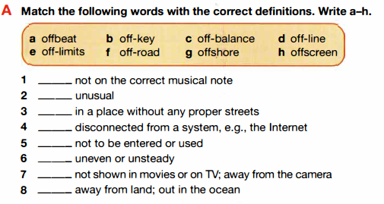
Vocabulary skill A– Prefix off-

Slide 35
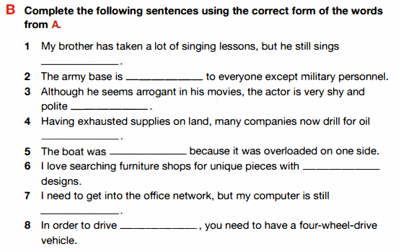
Vocabulary skill B– Prefix off-

Slide 36
Real life skill – Planning a trip Online
Think of a vacation destination you’d like to visit and make a plan. Be prepared and it’s useful for you in the future!
Destination
Transportation
Accommodation
Activities
Other info
Travel tips
determiners

Slide 37
Real life skill – Planning a trip Online
Think of a vacation destination you’d like to visit and make a plan. Be prepared and it’s useful for you in the future!
 | Search word | Company | Price
Transportation
Accommodation
Activity 1
Activity 2
Activity 3
Other info
Travel tips
determiners

